Slide 1
What Is Cortisol?
© 2024 Corcept Therapeutics. All rights reserved. MA-FLD-00196 SEP 2024

Slide 2




Physiological cortisol release: Preparing for activity
Cortisol secretion pattern¹
Night
Day
Night
15
Meal²
10
Blood cortisol level (μg/100 mL)
LNSC
test³
Meal²
AM
cortisol³
5
Dexamethasone³
1
2
3
4
5
6
7
8
9
10
11
12
13
14
15
16
17
18
19
20
21
22
23
24
Hour of the day
Notes:
Cortisol, one of the most potent hormones in human physiology,¹ is a steroid hormone and has an important role in the body’s metabolic reaction to physiological or psychological stress²
Additionally, one of the major functions of cortisol (glucocorticoids) is to facilitate energy utilization by stimulating gluconeogenesis in the liver and fat breakdown in adipose tissue, thereby preparing the organism for the impending active phase of the day, which is normally associated with increased energy demands³
Therefore, its secretion follows a 24-hour cycle, wherein cortisol peak levels are reached about 30 minutes after waking, known as the cortisol awakening response, after which its levels decline throughout the day, with minor elevations occurring after the midday and evening meals^{2,4}
Lowest levels of cortisol are usually seen during the early sleeping phase²
Several biochemical tests can be used to detect hypercortisolism:
The late-night salivary cortisol assay is carried out between 11 PM and midnight⁵
The 1-mg dexamethasone suppression test requires that patients take 1 mg of oral dexamethasone between 11 PM and midnight, and their serum cortisol level is measured in the following morning between 8 and 9 AM⁵
References:
Mohd Azmi NAS, et al. Int J Environ Res Public Health. 2021;18(2):676. doi:10.3390/ijerph18020676
Jones C, Gwenwin C. Physiol Rep. 2021;8(24):e14644. doi:10.14814/phy2.14644
Lin XW, et al. J Biol Rhythms. 2015;30(4):263-276.
Lovallo WR, Buchanan TW. Chapter 21. Stress hormones in psychophysiological research: emotional, behavioral, and cognitive implications. In: Cacioppo JT, Tassinary LG, Berntson GC, eds. Handbook of Psychophysiology. 4th ed. Cambridge University Press; 2017.
Ceccato F, Boscaro M. High Blood Press Cardiovasc Prev. 2016;23(3):209-215.

Slide 3
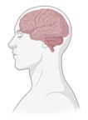








Cortisol production: Circadian signaling
Normal regulation¹⁻³
CLOCK GENES
Circadian signals
Normal cortisol circadian rhythm follows a diurnal variation¹
Stress
CLOCK
Sympathetic adrenal modulation
CRH
ACTH
CLOCK GENES
06h
10h
14h
18h
22h
02h
06h
CLOCK
Impact on peripheral tissues/organs²⁻⁵
Cortisol
Skeletal muscle
Heart
Liver
Pancreas
Adipose tissue
Immune system
Notes:
The circadian cycle, driven by clock genes in the hypothalamus, regulates the cortisol secretory pattern in a light-dependent manner by elevating cortisol secretion during the waking period and diminishing it during the sleep cycle^{1,2}
The production and secretion of cortisol are under hypothalamic and pituitary control, and driven by stress and circadian rhythm triggers under normal physiologic conditions³
The circadian rhythm and various stress stimuli drive the production of cortisol via the hypothalamic-pituitary-adrenal (HPA) axis through the release of corticotropin-releasing hormone (CRH) from the hypothalamus, which induces the pituitary gland to release adrenocorticotropic hormone (ACTH), which eventually leads to cortisol production from the adrenal gland⁴
Cortisol plays important roles in several physiological functions, such as metabolism, development, and cognition and is implicated in multiple organ systems⁵
Thus, cortisol influences several biological cyclical functions and serves as an important link in the circadian system by transmitting the circadian message to the peripheral tissues⁵
Cortisol signaling can modulate the HPA axis via a feedback loop to help regulate normal circadian rhythm⁶
References:
Lovallo WR, Buchanan TW. Chapter 21. Stress hormones in psychophysiological research: emotional, behavioral, and cognitive implications. In: Cacioppo JT, Tassinary LG, Berntson GC, eds. Handbook of Psychophysiology. 4th ed. Cambridge University Press; 2017.
Hsu CN, Tain YL. Int J Mol Sci. 2020;21(6):2232. doi:10.3390/ijms21062232
Timmermans S, et al. Front Immunol. 2019;10:1545. doi:10.3389/fimmu.2019.01545
Ahmed A, et al. Front Immunol. 2019;10:1438. doi:10.3389/fimmu.2019.01438
Mohd Azmi NAS, et al. Int J Environ Res Public Health. 2021;18(2):676. doi:10.3390/ijerph18020676
Moreira AC, et al. Eur J Endocrinol. 2018;179:R1-R18.

Slide 4
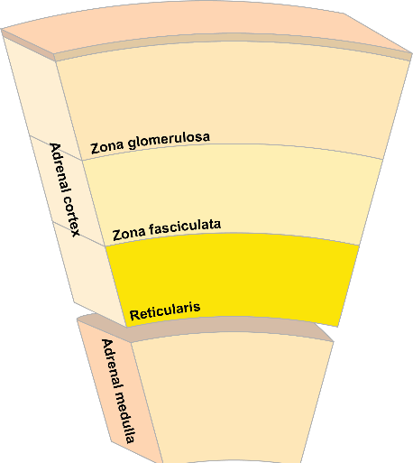
Cortisol production: Introducing the adrenal glands¹⁻⁴
Effect of ACTH on the adrenal gland
ACTH
Lipoprotein
Mineralo- corticoids
LDLR
Aldosterone
Endocytosis
MRAP
MC2R
SCARB1
ATP
cAMP
Gluco- corticoids
Cortisol
Cholesterol ester
PKA
ACTH
Androgens and
estrogens
Free cholesterol
Cortisol
HMGCR
Zona
Acetyl CoA
reticularis
STAR
Cholesterol
CYP11A1
Stress
Epinephrine Norepinephrine
Cortisol
Endoplasmatic reticulum
Mitochondrion
Notes:
Cortisol is produced and secreted from the adrenal gland—specifically from the zona fasciculata¹
The adrenal gland is the predominant site of synthesis of several hormones²
Cortisol is also involved in the regulation of production of epinephrine and norepinephrine from the adrenal medulla, which further indicates the importance of this hormone in the body³
The figure on the right depicts the subsequent effects of ACTH on the adrenal gland⁴
ACTH binds to its receptor, MC2R, located in the cell membrane of adrenocortical cells, which stimulates adenylate cyclase and thereby initiates steroidogenesis⁴
ACTH upregulates the expression of its own receptor; this mediates the release of cholesterol from lipid droplets while increasing the expression of genes encoding the proteins for cholesterol uptake (eg, LDLR and SCARB1) and cholesterol synthesis (via HMGCR)⁴
ACTH increases the expression of genes encoding key steroidogenic enzymes (eg, STAR and CYP11A1) that are upstream from cortisol production⁴
Impairments in cortisol signaling have been associated with certain mutations in the ACTH receptor (melanocortin 2 receptor, MC2R); in particular, one case of adrenal hyperplasia has been reported with a mutation in MC2R⁵
References:
Ahmed A, et al. Front Immunol. 2019;10:1438. doi:10.3389/fimmu.2019.01438
Timmermans S, et al. Front Immunol. 2019;10:1545. doi:10.3389/fimmu.2019.01545
Wurtman RJ, et al. Metabolism. 2002;51(6 Suppl 1):11-14.
Boonen E, et al. Lancet Diabetes Endocrinol. 2015;3:805-815.
Aza-Carmona M, et al. J Pediatr Endocrinol Metab. 2011;24:395-397.

Slide 5

Synthesis pathway for cortisol production¹⁻³
Zona reticularis
Cholesterol
Zona fasciculata
steroidogenic cells
Zona glomerulosa
Aldosterone
Cholesterol
Cortisol
Pregnenolone
Androgens and
estrogens
Pregnenolone
Zona reticularis
17α-OH-Pregnenolone
DHEA
Progesterone
17α-OH-Progesterone
DHEA-sulfate
11-Deoxycorticosterone
ER
11-Deoxycortisol
11-Deoxycorticosterone
11-Deoxycortisol
CORTICOSTERONE
Mitochondria
CORTISOL
Adrenal gland and other sites
18OH-Corticosterone
CORTISOL
(active)
11β-HSD1
Cortisone (inactive)
Aldosterone
11β-HSD2
Mineralocorticoid receptor
Cortisol receptor (GR)
Notes:
Key takeaway: Cholesterol undergoes several enzymatic steps in the steroidogenic cells within the zona fasciculata to be converted to cortisol¹
Cholesterol is the precursor to the production of several hormones, such as cortisol¹
The balance of active vs inactive cortisol (ie, cortisol vs cortisone, respectively) is regulated by the actions of 11β-HSD1/2 enzymes. This process occurs not only in the adrenal gland, but also in the kidney as well as other local sites in the body²
Since cortisol can cross-bind with mineralocorticoid receptor (MR), 11β-HSD2 is highly expressed in tissues with high MR expression (eg, kidney) to prevent cortisol-induced MR activation
Dehydroepiandrosterone/dehydroepiandrosterone-sulfate (DHEA/DHEA-S) are produced from 17α-hydroxypregnenolone in the zona reticularis
References:
Ahmed A, et al. Front Immunol. 2019;10:1438. doi:10.3389/fimmu.2019.01438
Timmermans S, et al. Front Immunol. 2019;10:1545. doi:10.3389/fimmu.2019.01545
Rainey WE, Nakamura Y. J Steroid Biochem Mol Biol. 2008;108:281-286.

Slide 6

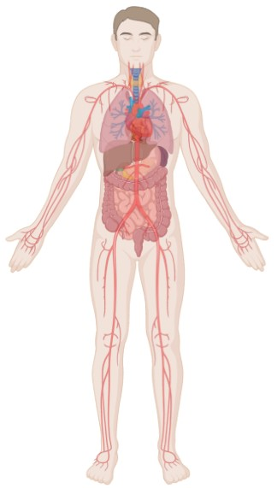




Cortisol drives physiological development and maintains homeostasis
Nearly all cells of the body are potential cortisol targets¹
Nervous System
Circadian rhythm
Stress reactivity
Behavior
Cognition and memory
Respiratory System
Cortisol plays important roles in many physiological processes in nearly all organs²⁻⁶
Lung development: Alveolar epithelial cell differentiation
Immune System
Cardiovascular System
Regulation of the inflammatory response (cytokine production)
Immune cell maturation and proliferation
Apoptosis of immune cells
Blood pressure regulation
Cardiomyocyte survival
Cardiac hypertrophy
Vascular inflammation
Liver and Adipose
Glucose and lipid metabolism
Reproductive System
Regulation of gonadal function in the HPG axis
Embryo implantation and development
Gastrointestinal System
Cell survival and proliferation
Bone
Muscle
Bone formation and resorption
Metabolism (anabolism & catabolism, glucose, lipid, and protein metabolism)
Notes:
Key takeaway: Nearly all the cells of the body are potential cortisol targets, hence cortisol plays important roles in many physiologic processes across nearly all organs in the body¹⁻⁶
This is partly indicated and attributed to the ubiquitous expression of the cortisol receptor^{1,2}
The figure highlights some of the essential physiologic functions that depend on cortisol signaling, including key body systems such as the nervous, cardiovascular, and immune systems
References:
Mohd Azmi NAS, et al. Int J Environ Res Public Health. 2021;18(2):676. doi:10.3390/ijerph18020676
Timmermans S, et al. Front Immunol. 2019;10:1545. doi:10.3389/fimmu.2019.01545
Cruz-Topete D, et al. Front Endocrinol. 2020;11:347. doi:10.3389/fendo.2020.00347
Sulaiman RS, et al. Steroids. 2018;133:60-66.
Gerber AN. Chapter 12: Glucocorticoids and the lung. In: Wang J-C, Harris C, eds. Glucocorticoid Signaling. New York, NY: Springer; 2015.
Whirledge S, Cidlowski JA. Minerva Endocrinol. 2010;35:109-125.

