Slide 1
Negative Impact of Hypercortisolism on Cardiovascular Health
© 2024 Corcept Therapeutics. All rights reserved. MA-FLD-00196 SEP 2024
Notes:
© 2023 Corcept Therapeutics. All rights reserved. MA-FLD-00101 MAY 2023

Slide 2
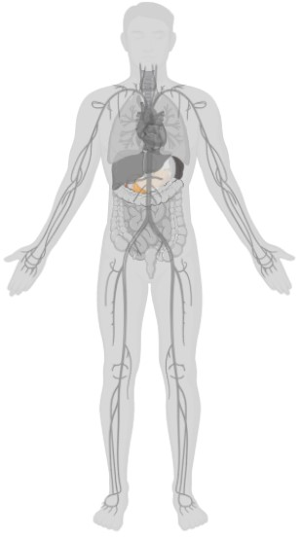

Cardiovascular consequences
Physiological role of cortisol¹
Cardiovascular consequences of excess cortisol²⁻⁵
Up to 85%
Hypertension^{2,3}
Cardiovascular System
Up to 20%
Cardiomyocyte survival
Cardiac hypertrophy
Vascular inflammation
Blood pressure regulation
Thromboembolic events⁴
2x risk
Myocardial infarction⁴
6x risk
Cardiac failure⁴
Up to 100%
Cardiovascular-related mortality⁵
Notes:
Key takeaway: Excess cortisol can affect multiple systems—in particular, cardiovascular disease is a common clinical consequence of hypercortisolism, and is commonly reported as the main cause of death in patients with hypercortisolism¹
A review of published literature up to 2018 showed cardiovascular-related mortality rates range between 19% and 100%, depending on etiology (higher in ectopic source), vs a rate of 31% of all global deaths in the general population^{2,3}
Specifically, hypercortisolism predisposes patients to a 2-fold and a 6-fold increased risk of myocardial infarction and cardiac failure, respectively¹
Hypertension, the main cardiovascular risk factor, is commonly reported with hypercortisolism—up to 85% of patients^{4,5}
References
Pivonello R, et al. Lancet Diabetes Endocrinol. 2016;4:611-629.
Javanmard P, et al. Endocrinol Metab Clin N Am. 2018;47:313-333.
Cardiovascular diseases factsheet. World Health Organization. Updated June 11, 2021. Accessed July 9, 2024. https://www.who.int/en/news-room/fact-sheets/detail/cardiovascular-diseases-(cvds)
Braun LT, et al. Front Endocrinol (Lausanne). 2019;10:766.
Prete A, et al. Ann Intern Med. 2022;175(3):325-334.

Slide 3
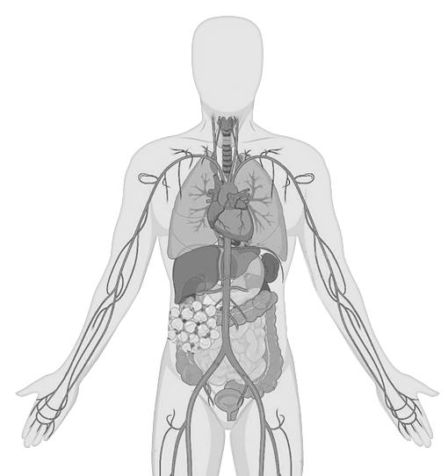


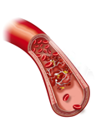
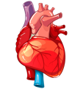
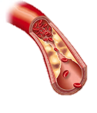

Excess cortisol negatively impacts cardiac structure/function, blood pressure, and coagulation
Hypertension¹
Renin-angiotensin system
Mineralocorticoid activity
Sympathetic nervous system
Vasoconstriction
Cardiovascular risks
Metabolic syndrome
Vascular atherosclerosis¹
Dyslipidemia
Inflammation
Insulin resistance
Impaired glucose tolerance
Diabetes mellitus
Visceral obesity
VTE^{1,2}
FVIII
vWF
Fibrinogen
PAI-1
Inflammation²
Cardiac comorbidities¹
Arrhythmia
Left ventricular hypertrophy
Changes in wall thickness
Myocardial fibrosis
Hypokalemia
Notes:
Key takeaway: Excess cortisol can have multiple impacts on the cardiovascular system, increasing the risk of cardiovascular disease and death
Hypertension is very common in hypercortisolism; the associated mechanisms include changes in the renin-angiotensin system and the sensitivity of sympathetic nervous system
Cardiac and vascular damages have also been reported
Atherosclerosis is a common feature of hypercortisolism, which may be attributed to several factors, including insulin resistance, cortisol-induced endothelial dysfunction, and thrombosis diathesis. Vascular damage may further contribute to the incidence of stroke, another complication observed with hypercortisolism
Cardiac damage as a complication of hypercortisolism can include cardiac hypertrophy, myocardial fibrosis, infarction, and cardiac failure
Reference
Pivonello R, et al. Lancet Diabetes Endocrinol. 2016;4:611-629.

Slide 4





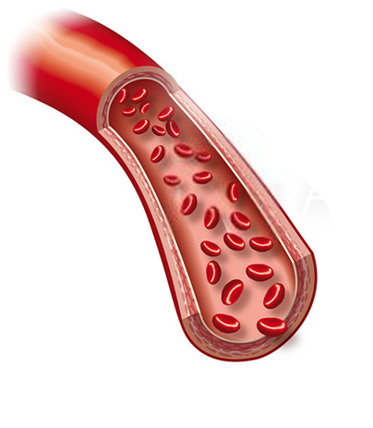
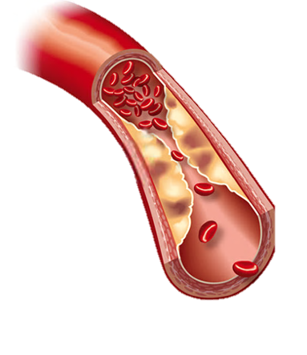
Excess cortisol increases the risk of atherosclerosis
Pathophysiology of atherosclerosis¹⁻²
Macrophages
Indicators of atherosclerosis were significantly elevated in patients with CS compared with patients with
essential hypertension³
+
LDL
Lipolysis
Foam cells
Media (muscular layer of artery)
Intima (normally thin)
Variable | CS (n=30) | EH (n=35) | Control (n=30)
cIMT, mm | 0.93 (0.17)ª | 0.81 (0.16) | 0.75 (0.24)
Plaque, % | 26.6ª | 16 | 0
ABI^{b} (<0.9), % | 20ª | 3 | 0
Adventitia (lining of artery)
Plaque
Effects of excess cortisol^{3,4}
Endothelial dysfunction
VEGF
Intima-media thickness
Carotid plaques
The risk of myocardial infarction increases 43% with every 0.163-mm increase in cIMT⁴
Increased lipolysis and free fatty acid accumulation²
Flow-mediated dilation
Notes:
Key takeaway: Excess cortisol can contribute to increased fatty acid accumulation—a key pathomechanism for the development of atherosclerosis^{1,2}
The fatty streak phase of atherosclerosis begins with dysfunctional endothelial cells as well as the retention of lipids, such as low-density lipoprotein and very low-density lipoprotein (VLDL)^{2,3}
Excess cortisol plays an important role in the development of endothelial dysfunction, and patients with CS exhibit several humoral markers of endothelial dysfunction⁴
These lipoproteins promote activation of endothelial cells, which leads to recruitment of immune cells^{2,3}
Recruited monocytes can differentiate into macrophages, which then internalize lipids to become foam cells^{2,3}
Foam cells play critical roles in the development of atherosclerosis^{2,3}
Additionally, patients with CS have been shown to have higher levels of vascular endothelial growth factor, a highly specific chemotactic and mitogenic factor for vascular endothelial cells that is thought to induce neoangiogenesis and thereby contribute to the development and stabilization of atherosclerotic plaques, than patients with essential hypertension⁵
Various markers of atherosclerosis, such as increased intima-media thickness (IMT), increased prevalence of carotid plaques, and lower flow-mediated dilation, were found to be higher in patients with CS compared with healthy controls⁵
A study of 30 patients with CS (12 patients had ACTH-dependent CS and 18 patients had ACTH-independent CS), 35 age-matched patients with essential hypertension, and 30 control (healthy) subjects found that CS patients showed a significant increase of carotid IMT and a higher prevalence of plaques compared to both healthy subjects and those with essential hypertension⁴
Additionally, compared with healthy subjects or patients with essential hypertension, a significantly higher percentage of CS patients had a pathological value for ankle-brachial index (ABI; ie, <0.9).
A low ABI can increase the risk of cardiovascular mortality^{4,5}
References
Magomedova L, Cummins CL. Handb Exp Pharmacol. 2016;233:73-93.
van der Sluis RJ, Hoekstra M. Mol Cell Endocrinol. 2020;504:110728.
Linton MF, et al. In: Endotext [Internet]. South Dartmouth (MA): MDText.com, Inc.; 2000-2019 Jan 3.
Petramala L, et al. Endocrinol Metab (Seoul). 2015;30(4):488-493.
Lupoli R, et al. Ann Med. 2017;49:206-216.

Slide 5
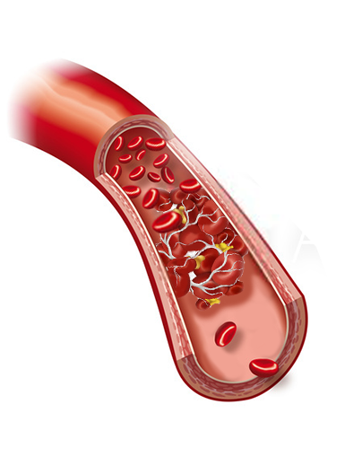
Excess cortisol promotes coagulation and increases the risk of thrombosis
Excess cortisol modulates several factors involved in coagulation³
Cortisol
Variable | Role in coagulation | Change in patients with CS
vWF | Mediates platelet adhesion
aPTT | Coagulation time
FVIII | Promotes coagulation
Fibrinogen | Promotes coagulation
PAI-1 | Inhibitor of fibrinolysis
TAFI | Inhibitor of fibrinolysis
α2-antiplasmin | Inhibitor of fibrinolysis
Odds ratio of VTE¹
Meta-analysis of 7142 patients with endogenous hypercortisolism
Blood clot
17.82
Excess cortisol can promote coagulation and impair fibrinolysis
Activated partial thromboplastin time¹
Clot lysis time²
Notes:
Key takeaway: Excess cortisol can lead to changes in coagulation cascades that result in increased risk of venous thromboembolism¹
Excess cortisol can lead to reduced activated partial thromboplastin time,² thereby enhancing coagulation, and increased clot lysis time,³ thereby impairing the process of fibrinolysis
Excess cortisol modulates several factors involved in coagulation and increases the risk of venous thromboembolism (VTE)
Patients with CS have been found to have increased levels of clotting factors, such as von Willebrand factor, factor VIII, and fibrinogen, and increased levels of factors that inhibit fibrinolysis, such as plasminogen activator inhibitor type 1 and thrombin activatable fibrinolysis inhibitor¹
In a systemic meta-analysis of over 7000 patients with endogenous hypercortisolism, the odds ratio of spontaneous VTE was found to be 17.82 when compared with a healthy population²
References
Isidori AM, et al. Eur J Endocrinol. 2015;173:R101-R113.
Wagner J, et al. Front Endocrinol (Lausanne). 2019;9:805. doi:10.3389/fendo.2018.00805
van der Pas R, et al. Clin Endocrinol (Oxf). 2013;78(4):481-488.

Slide 6
Mortality risk: Need for timely diagnosis and treatment
Standardized Mortality Ratioª
Most common causes of death
Meta-analysis of 68 study cohorts that included 592 deaths among 7255 patients
Pooled CS (CD + ACS)
20 study cohorts (n=3691)
3x
2.8x
43.4%
43.7%
CS
Cushing disease (CD)
13 study cohorts (n=2160)
38.6%
CD
ACS
Active CD
8 study cohorts (n=206)
5.7x
Remission from CD
8 study cohorts (n=1103)
2.3x
15.9%
12.7%
11.5%
Adrenal CS (ACS)
7 study cohorts (n=1531)
3.3x^{b}
CVD^{c}
Infection
Notes:
Key takeaway: Patients with hypercortisolism are at an increased risk of death, which is a direct consequence of the associated comorbidities, and therefore require early diagnosis and timely treatment
A prospective systematic review and meta-analysis determined the all-cause and cause-specific mortality of patients with endogenous CS, as well as the cause of death in these patients
Mortality was depicted as standardized mortality ratio (SMR), which represented the number of CS deaths in the study compared with the expected number of deaths in an age- and sex-matched normal population
The SMR analyses encompassed 14 articles reporting on 20 cohorts including 3691 patients; of the 20 SMR cohorts, 13 were Cushing disease (CD) cohorts (n=2160) and 7 were adrenal CS (ACS) cohorts (n=1531)
The pooled SMR for all patients with CS was 3 (95% CI, 2.33-3.85)
The SMR for CD was 2.8 (95% CI, 2.11-3.72)
The SMR for ACS was 3.34 (95% CI, 1.68-6.63)
SMR was higher in patients with active CD (SMR = 5.7; 95% CI, 3.73-8.73) than those in remission from CD (SMR = 2.3; 95% CI, 1.29-4.01)
Eighty-two articles described 92 cohorts containing 19,181 patients with CS, reporting the number (or proportion) of deaths. The causes of death in patients with CS were reported in 68 study cohorts; the major contributor to excess mortality was cardiovascular disease (CVD, comprising atherosclerotic heart disease, cerebrovascular disease, and venous thromboembolism), and the second most common cause of death was infection
In all patients with CS: CVD and infections resulted in 43.4% and 12.7% of deaths, respectively
In patients with CD: CVD and infections resulted in 43.7% and 11.5% of deaths, respectively
In patients with ACS: CVD and infections resulted in 38.6% and 15.9% of deaths, respectively
Reference:
Limumpornpetch P, et al. J Clin Endocrinol Metab. 2022;107(8):2377-2388.

