Slide 1
Metabolic Dysregulation in Hypercortisolism
© 2024 Corcept Therapeutics. All rights reserved. MA-FLD-00196 SEP 2024
Notes:
© 2023 Corcept Therapeutics. All rights reserved. MA-FLD-00101 MAY 2023

Slide 2
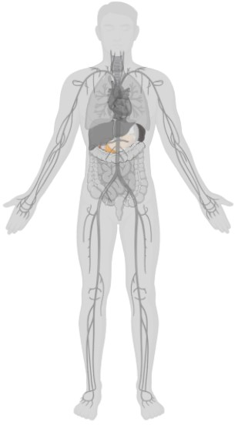

Hypercortisolism is associated with several metabolic impairments
Physiologic role of cortisol¹
Consequences of excess cortisol
Up to 64%
Abnormal glucose tolerance²
Up to 47%
Diabetes²
Liver and Adipose Metabolism
Up to 71%
Glucose and lipid metabolism
Dyslipidemia²
Up to 100%
Visceral obesity³
Notes:
Key takeaway: Excess cortisol can affect multiple systems—in particular, the liver and adipose tissue
Glucose impairment has been described in up to 64% of patients with hypercortisolism¹
Abnormal glucose tolerance: 21%-64%¹
Diabetes: 20%-47%¹
In comparison, the WHO 2014 estimate of the global prevalence of diabetes in people 18 years and older was almost 9%²
Based on several studies spanning 2 decades, the estimated prevalence of dyslipidemia in hypercortisolism ranges from 38%-71%¹
Estimated prevalence rate of dyslipidemia in the general US population is 22%
The preferential visceral accumulation of fat tissue and weight gain is among the most common features of hypercortisolism—prevalence ranges from 57% to 100%⁴
References:
Braun LT, et al. Front Endocrinol (Lausanne). 2019;10:766.
Cardiovascular diseases factsheet. World Health Organization. Updated June 11, 2021. Accessed July 9, 2024. https://www.who.int/en/news-room/fact-sheets/detail/cardiovascular-diseases-(cvds)
Steffensen C, et al. Horm Metab Res. 2019;51:62-68.
Pivonello R, et al. Lancet Diabetes Endocrinol. 2016;4:611-629.

Slide 3
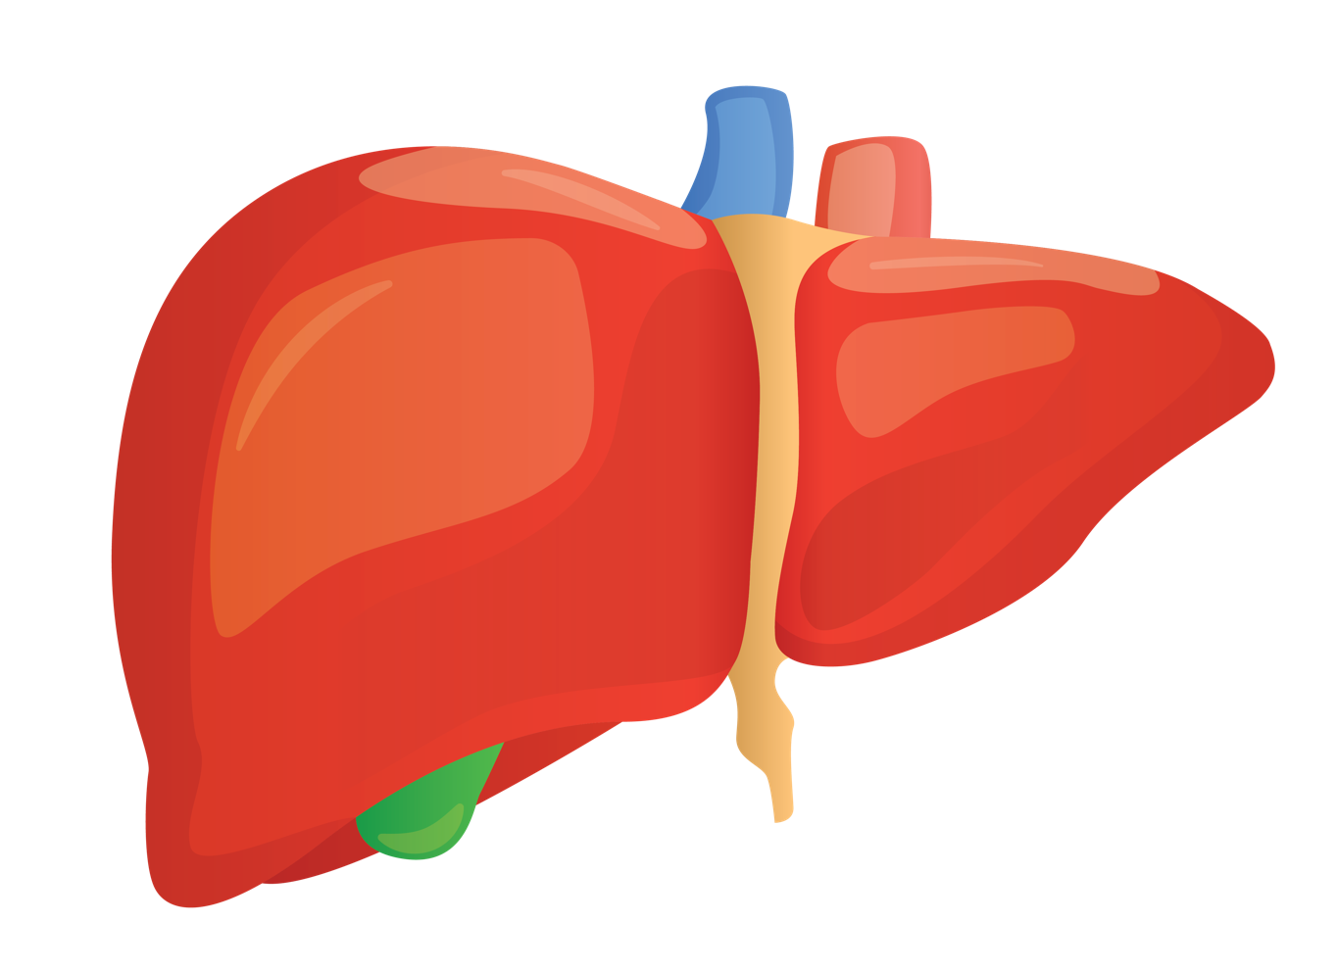
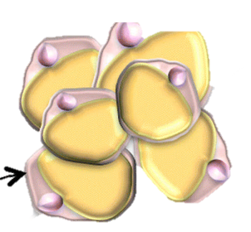
Excess cortisol stimulates lipogenesis and dysregulates cholesterol metabolism¹⁻³
Adipose tissue
Cortisol
↑ Lipase
↑ Fatty acid
↑ Bile acid uptake
Increased
cholesterol
↑ Lipogenesis
↑ Amino acid ↑ Glycerol
↑ Ceramide synthesis
Cortisol
↑Gluconeogenesis
Hepatic steatosis
Insulin resistance
↑ Glucose ↑ Insulin
↑ Food intake
Notes:
Key takeaway: Excess cortisol can stimulate lipogenesis via its actions on adipose tissue and modulation of food intake
Appetite can be influenced by increased cortisol via reduction in the sensitivity to leptin and/or modulation of the activity of the appetite-stimulating neuropeptide Y¹
Increased gluconeogenesis and glycogenolysis increase glucose uptake. Increased insulin can stimulate lipogenesis and lipid droplet deposition¹
Elevated insulin and cortisol increase lipogenesis by directly upregulating the expression of 2 key enzymes involved in fatty acid synthesis²
As a result, VLDL synthesis and secretion are increased, increasing triglyceride release into the bloodstream; excess cortisol also increases hepatic triglyceride stores in the liver^{2,3}
Cortisol can also stimulate lipolysis in the peripheral adipose tissues, releasing fatty acids and triglycerides^{1,2}
Excess cortisol affects both the input and output of the metabolic pathways that lead to excess lipid deposition in the liver¹
For example, the loss of the suppressive effects of insulin on lipolysis in adipose tissue increases free fatty acids. These excess free fatty acids enter the liver to stimulate the assembly and secretion of VLDL¹
Cortisol decreases beta-oxidation of fatty acids via inhibition of the acyl-CoA dehydrogenases (ACADs), further contributing to intracellular lipid accumulation¹
Impaired insulin signaling can also lead to dyslipidemia via increased production of triglycerides, HDL, and lipid droplets, as well as fatty acids from adipose tissues^{2,3}
As a result, VLDL synthesis and secretion are increased, leading to increased release of triglycerides into the bloodstream; excess cortisol also results in a net increase in hepatic triglyceride stores^{2,3}
Insulin resistance also decreases lipoprotein lipase activity, a major mediator of VLDL clearance, and thus may contribute to higher VLDL levels in the plasma
Overall, excess cortisol can lead to the ectopic accumulation of fat in the liver, termed hepatic steatosis, which is implicated in the development of insulin resistance and metabolic syndrome²
This is mainly attributed to (1) increased fatty acid synthesis, (2) decreased fatty acid oxidation, and (3) increased VLDL synthesis/secretion
References:
Rahimi L, et al. Diabetes Metab Sundr Obes. 2020;13:1133-1145.
Magomedova L, Cummins CL. Handb Exp Pharmacol. 2016;233:73-93.
Ormazabal V, et al. Cardiovasc Diabetol. 2018;17:122.

Slide 4
Excess cortisol can increase food intake and fat accumulation^{1,2}
Leptin
Leptin sensitivity
Leptin reduces appetite under normal conditions
Excess cortisol reduces sensitivity to leptin, leading to hyperphagia
Neuropeptide Y (NPY)
NPY neuronal activity
↑ Food intake
NPY stimulates appetite under normal conditions
Excess cortisol increases NPY neuronal activity, leading to increased food consumption
↑ Glucose ↑ Insulin
Fat accumulation
Insulin resistance
Notes:
Key takeaway: Excess cortisol may increase food intake and fat accumulation via modulation of key genes that are involved in regulating appetite and food intake
Under normal conditions, leptin will act in the hypothalamus to reduce appetite, food intake, and hence, weight gain^{1,2}
Excess cortisol inhibits the signaling pathway downstream of the leptin/leptin receptor complex, resulting in increased appetite (hyperphagia), increased food intake, and subsequently, insulin resistance due to hypercholesterolemia¹
Excess cortisol also increases neuropeptide Y concentration in the hypothalamus, resulting in hyperphagia, hyperinsulinemia, insulin resistance, and weight gain^{3,4}
References:
Rahimi L, et al. Diabetes Metab Syndr Obes. 2020;13:1133-1145.
Geer EB, et al. Endocrinol Metab Clin North Am. 2014;43:75-102.
Lim CT, et al. J Mol Endocrinol. 2010;44:87-97.
Huynh MKQ, et al. Neural Plast. 2016;2016:2754078.

Slide 5

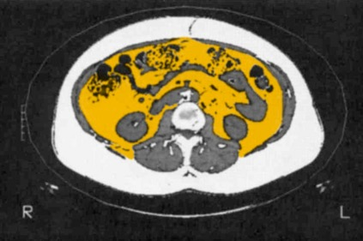
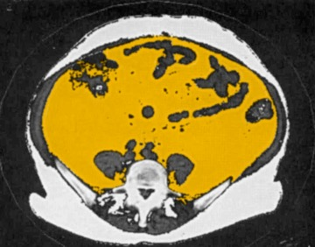
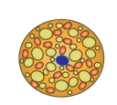
Excess cortisol can cause visceral fat accumulation without obvious obesity
Effects of Cortisol on Adipose Tissues^{1,2}
Abdominal CT scan showing increased adipose deposition²
Cortisol
Healthy control
Active Cushing’s syndrome
Subcutaneous
Lipolysis
Mortality (HR ± 95% CI)ª in women with visceral vs subcutaneous abdominal fat³
Visceral
cortisol
HR
11β-HSD1
cortisone
Visceral fat
Adipogenesis
<25
25 to <30
≥30
Subcutaneous fat
BMI
Notes:
Key takeaway: Patients with hypercortisolism exhibit a preferential accumulation of visceral fat¹
The preferential visceral accumulation of fat tissue and weight gain are among the most common features of hypercortisolism²
While central obesity is a common clinical characteristic of hypercortisolism, it does not manifest in all patients. Central obesity should raise suspicion of hypercortisolism, especially if present with other additional features of the disorder, and should suggest the need for further evaluation and testing³
Data from 2900 women in the Age, Gene/Environment Susceptibility (AGES)-Reykjavik Study showed that visceral fat (per SD increment) significantly increased mortality risk⁴
References:
Lee MJ, et al. Biochemica et Biophysica Acta. 2014;1842:473-481.
Pivonello R, et al. Lancet Diabetes Endocrinol. 2016;4:611-629.
Nieman LK, et al. J Clin Endocrinol Metab. 2008;93:1526-1540.
Koster A, et al. Obesity (Silver Spring). 2015;23(4):893-897.

Slide 6

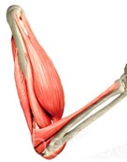

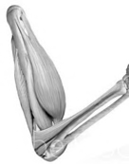
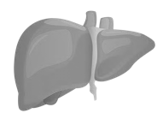


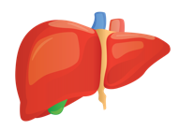

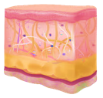

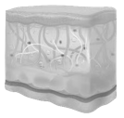
Excess cortisol contributes to the development of metabolic syndrome
Cortisol
Liver
Gluconeogenesis
Lipoprotein secretion
Fatty acid synthesis
Hepatic glucose resistance
Hepatic insulin resistance
Liver steatosis
Bone
⬇ Osteocalcin
Pancreas
⬇ Insulin secretion
Brain
Appetite
Adipose tissue
Pre-adipocyte to adipocyte differentiation
Amino acid uptake
GLUT4 translocation
Lipogenesis
⬆ Lipolysis
Skeletal muscle
GLUT4 translocation
Lipid oxidation
Cardiovascular
⬆ High blood pressure
⬆ Blood glucose
⬆ Body weight and fat accumulation
⬆ Hypertension
⬆ Peripheral insulin resistance
Abnormal lipid metabolism
Metabolic syndrome^{1,2}
Notes:
Key takeaway: Central obesity, dyslipidemia, and insulin resistance are key factors that contribute to the development of metabolic syndrome, a common comorbidity in hypercortisolism
Other contributing factors include hypertension, hyperglycemia, and cardiovascular diseases
Reference:
Pivonello R, et al. Lancet Diabetes Endocrinol. 2016;4:611-629.

